Slide 1
Introduction to Non-Archimedean Physics of Proteins.
Lecture III
p-Adic models of spectral diffusion and CO-rebinding
Spectral diffusion in frozen proteins and first passage time distribution for ultrametric random walk.
CO-rebinding to myoglobin and p-adic equations of the "reaction-diffusion" type.
Concluding remarks: molecular machines, DNA-packing in chromatin, and origin of life.

Slide 2
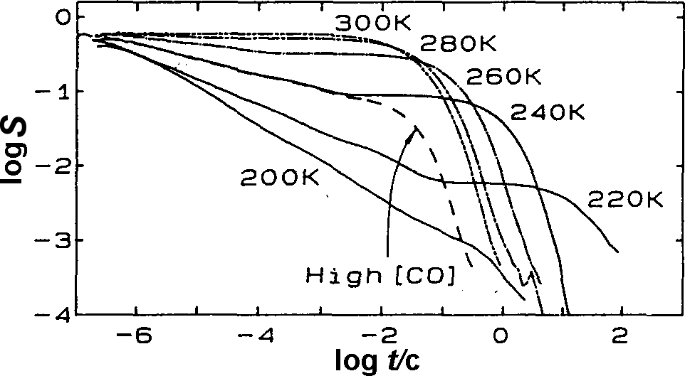
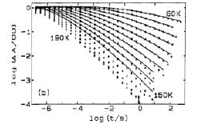
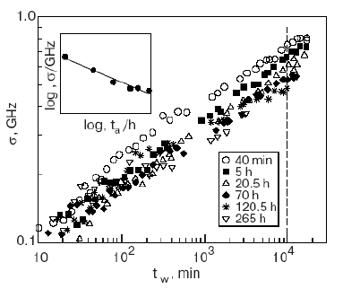
We wont to describe the spectral diffusion and CO rebinding kinetics using p-adic equation of ultrametric diffusion as a model of protein conformational dynamics
CO rebinding
protein dynamics
spectral diffusion
Mb*
?
?
Mb₁
protein conformational space
X
binding CO

Slide 3
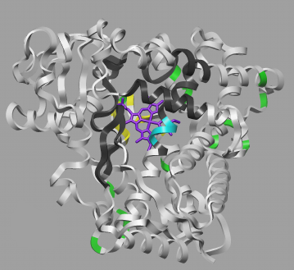
recall the experiments
Spectral diffusion in proteins
chromophore marker
1. Chromophore markers are injected inside the protein molecules. A sample is frozen up to a few Kelvin, and the adsorption spectrum is measured.
Due to variations of the atomic configurations around the chromophore markers in individual protein molecules the spectrum is inhomogeneously broadened at low temperatures.
2. Using a laser pulse at some absorption frequency, a subset of markers in the sample is subjected irreversible photo-transition. Thus, a narrow spectral hole is burned in the absorption spectrum.
3. The time evolution of the hole wide is measured.

Slide 4
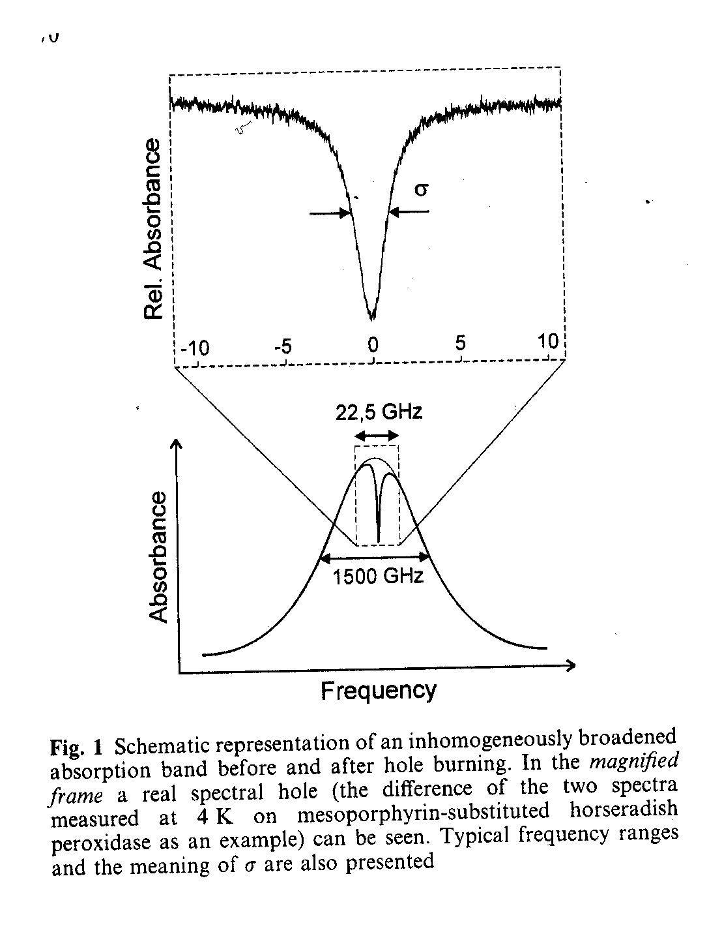
Spectral diffusion characteristics
The hole is well approximated by Gaussian distribution.
Thus, the spectral diffusion in frozen proteins is regarded as a Gaussian random process propagating along the frequency straight line.

Slide 5
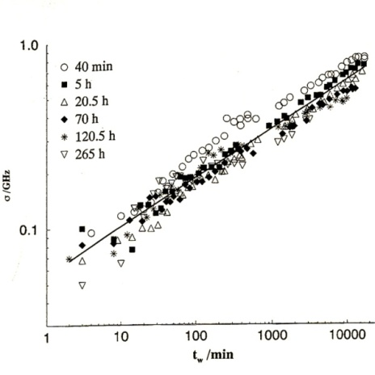
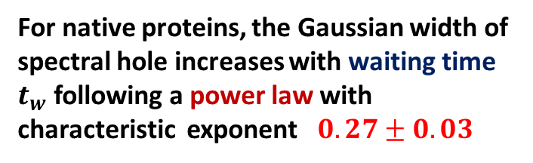
Spectral diffusion characteristics
For native proteins, the Gaussian width of spectral hole increases with waiting time $t_{w}$ following a power law with characteristic exponent $0.27±0.03$
Thus, spectral diffusion propagates much slower then the familiar (Brownian) diffusion.
waiting time starts immediately after burning of a hole

Slide 6
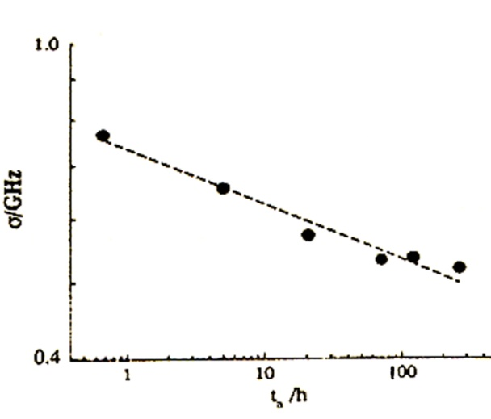
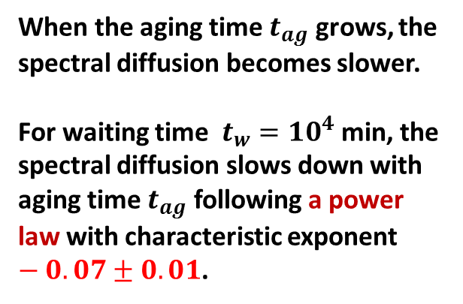

Spectral diffusion “aging” : the “aging time” is the interval between the time point at which a sample is suggested to be in a prepared state, and the time point at which a hole is burned.
When the aging time $t_{ag}$ grows, the spectral diffusion becomes slower.
For waiting time $t_{w}={10}^{4}$ min, the spectral diffusion slows down with aging time $t_{ag}$ following a power law with characteristic exponent $−0.07±0.01$.
$σ_{ν}(t_{ag},t_{w}={10}^{4} min)\sim t_{ag}^{−0.07}$
Although the temperature, absorption spectrum, and other physical characteristics indicate that a sample is in the thermal equilibrium, the spectral diffusion aging clearly shows that the distribution over the protein states does not reach the equilibrium even on very long-time-scales.

Slide 7
Our aim: Based on information about local atomic movements in protein globule, we want to make some conclusions about global (conformational) dynamics of protein molecule.
In the spectral diffusion experiment, the key question is how local stochastic motions in the marker surroundings are coupled to global rearrangements of protein conformations.
chromophore marker
protein dynamics
local rearrangements of the marker surroundings
?
p-adic equation of protein dynamics

Slide 8
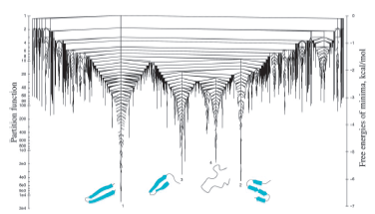
How random jumps of marker’s absorption frequency are coupled with random transitions between the protein conformational states
Let us compare the number of atomic configurations of marker’s surroundings distinguishable in the marker absorption frequency and the number protein conformational states, i.e. the number of local minima on protein energy landscape.
An estimate of the first is given by the ratio of the sample absorption band
(~10³ GHz) to the absorption line-width of an individual marker (~0.1 GHz). This gives about of 10⁴ frequency-distinguishable configurations of the marker neighbors.
In contrast, the protein state space is “astronomically” large: the number of local minima on the protein energy landscape can be as large as 10¹⁰⁰.
Although these estimates are of a symbolic nature, when comparing 10¹⁰⁰ and 10⁴ , we can certainly conclude that almost all transitions between the minima on the protein energy landscape do not result in changes of the marker absorption frequency.

Slide 9

Therefore, the spectral diffusion is due to rare random events occurring in the midst of changes of protein conformational states. Such rare events can be associated with hitting very particular protein states.
We call such states “zero-points” of the protein dynamic trajectory, and a time series (when the trajectory hits zero points) we call “zero-point clouds”.
$$σ_{ν}(t_{ag},t_{w})\sim t_{ag}^{−0.07}t_{w}^{0.27}$$
Thus, the spectral diffusion in proteins can be regarded as a one-dimensional Gaussian random process whose time-series is given by “zero-point clouds” of the protein dynamic trajectory.

Slide 10

”3-2” model of spectral diffusion in proteins
Physics: marker absorption frequency changes at the time points when protein hits very peculiar conformational states related to local rearrangement of the marker surroundings.
Two objects:
protein and chromophore marker
Two spaces:
ultrametric space of the protein states and 1-d Euclidian space of the marker frequency states
Two random processes
non-Archimedean random walk (protein) and Archimedean random walk (chromophore marker)
marker
n(τ) is the number of times the protein dynamic trajectory hits the “zero points” (number of returns) during the time interval τ=[t_{ag}, t_{ag}+t_{w}]
protein
frequency jumps (spectral diffusion)
mean number of returns for ultrametric random walk

Slide 11




Mathematics
ultrametric diffusion (protein dynamics)
first passage time distribution
Avetisov V. A., Bikulov A. Kh., Zubarev A. P.
J. Phys. A.: Math. Theor., 2009, 42, 85003
mean number of returns during a time interval [t_{ag}, t_{ag}+t_{w}]
survival probability
spectral diffusion broadening and aging
Avetisov V. A., Bikulov A. Kh.,
Biophys. Rev. Lett. , 2008, 3, 387

Slide 12
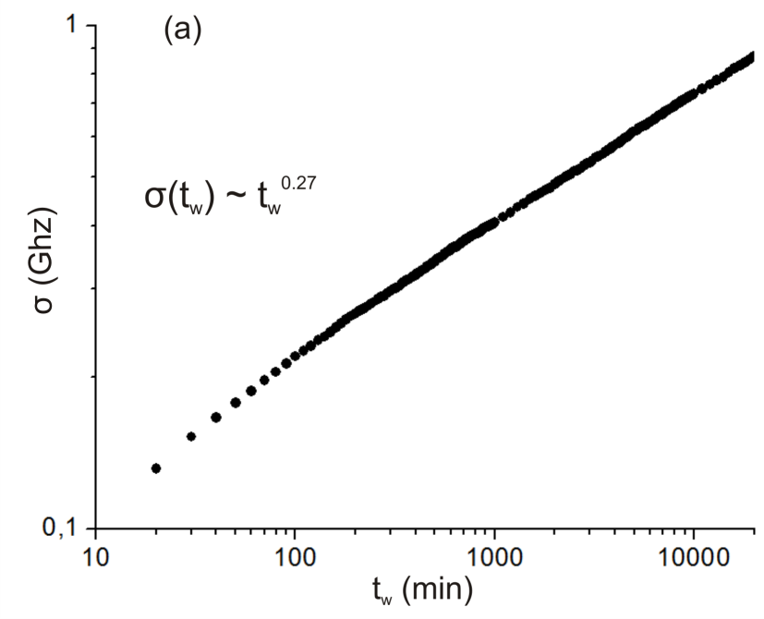
spectral diffusion broadening
experiment
ultrametric model

Slide 13
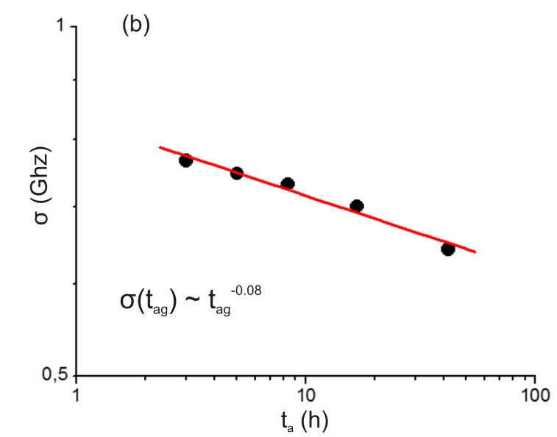

spectral diffusion aging at wighting time $t_{w}≈{10}^{4} (min$)
ultrametric model
experiment
$Δ_{0}=0.3 GHz$ , α=2.2

Slide 14
Characteristic exponents of the spectral diffusion broadening and aging are determined by the first passage time distribution for ultrametric random walk

Slide 15
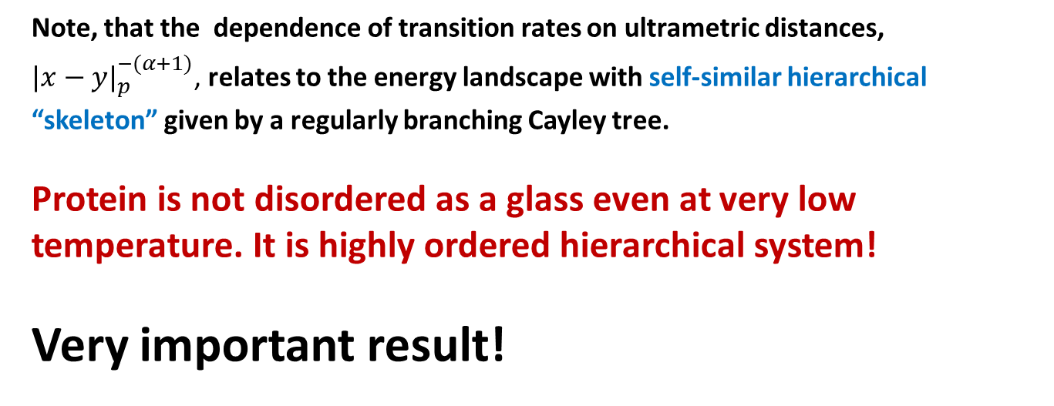
Thus, the features of spectral diffusion in frozen proteins suggest the protein ultrametricity:
Note, that the dependence of transition rates on ultrametric distances, ${|x−y|}_{p}^{−(α+1)}$, relates to the energy landscape with self-similar hierarchical “skeleton” given by a regularly branching Cayley tree.
Protein is not disordered as a glass even at very low temperature. It is highly ordered hierarchical system!
Very important result!

Slide 16
CO rebinding kinetics

Slide 17
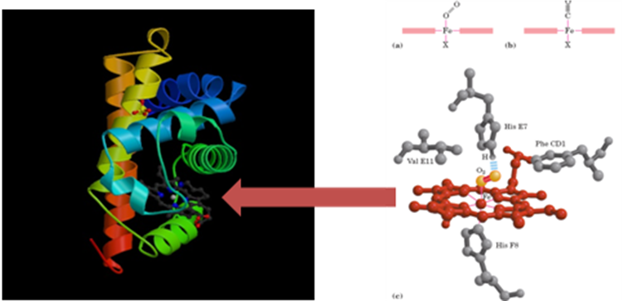
Recall the experiment
measurand :.
concentration of free (unbounded) Mb.
stressed (inactive) state
Mb*
conformational rearrangements of the Mb
Mb₁
equilibrated (active) state
CO
breaking of chemical bound
Mb-CO
rebinding CO to Mb
Mb-CO
Mb-CO
hν
laser pulse

Slide 18
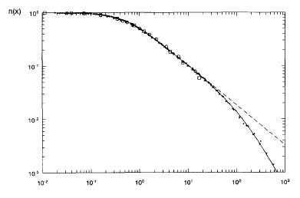
Exponents of power-law approximations for rebinding at low and high temperatures are dramatically different
anomalous temperature behavior
normal temperature behavior

Slide 19

Could we say that the CO-rebinding kinetics suggest the protein ultrametricity?
To say so, the kinetic features should be obtained from p-adic description of protein dynamics.
protein dynamics
?

Slide 20
Model of the “reaction-diffusion” type
Avetisov V.A., Bikulov A. Kh., Kozurev S. V., Osipov V. A, Zubarev A. P.; publications 2003-2012
The key idea: the reaction kinetics, i.e. the number of acts of binding for given time interval, is determined by the number of hits of a protein into the active conformations. In other words, both the CO-rebinding and the spectral diffusion are determined by one and the same statistics.
Mathematical model
Mb*
Mb₁
protein conformational space
X
binding CO
Transition rates ${|x−y|}_{p}^{−(α+1)}$ corresponds to the self-similar protein energy landscape

Slide 21
How are proteins distributed over conformational states just after the laser pulse?

Slide 22
Important detail of the experiment
Around of 200-180 K, i.e. closely at the border of high temperature and low temperature regions , a protein molecule undergoes “glassy transition” with sharp reducing of its fluctuation mobility.
Therefore, one and the same time window can relate to the long-time scales at high temperatures, and to the short and intermediate time-scale at low temperature.
In the last case, the rebinding kinetics (the number of returns ) can depend on initial distribution over protein conformational space, in contrast to long-time behavior at high temperatures.

Slide 23
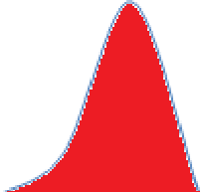
Simple idea.
We suggest that the form of initial distribution is determined by ultrametric diffusion before the laser pulse.
Specifically, the initial distribution has a maximum on some distance from the reaction sink and decreases in inverse proportion to ultrametric distance from the maximum.
protein diffuses over ultrametric conformational space
Z_{p}
B_{r}
reaction sink
Initial
distribution
protein binds CO in particular conformations

Slide 24
p-adic model of CO rebinding kinetics
measured quantity:

Slide 25
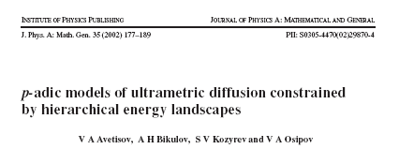
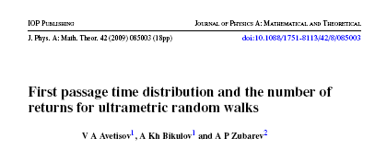
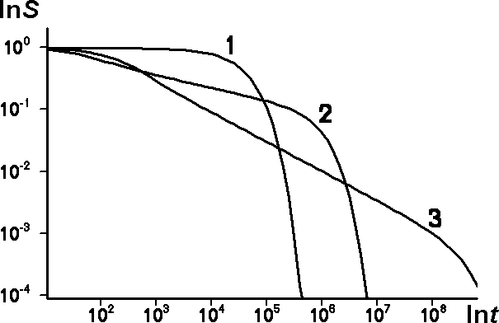
At high temperature, the power-law kinetics directly relates to the long-time approximation of the number of returns for ultrametric random walks
Note, that the long-time approximation does not depend on particular form of initial distribution.

Slide 26

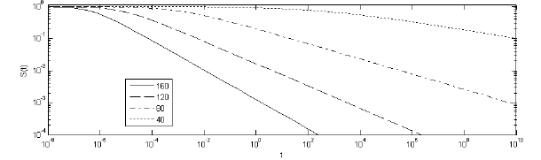
Low-temperature paradox
At low temperatures, the rebinding kinetics is also defined by the hits of protein molecule into the reaction sink area in the conformational space.
Note, that on the short and intermediate time-scales the rebinding kinetics depends on the initial distribution over protein conformations.

Slide 27
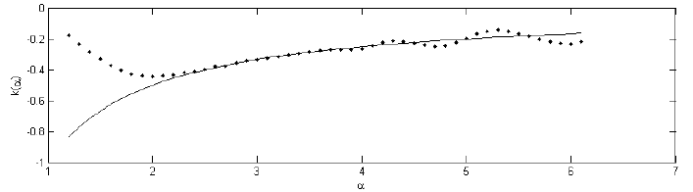
Temperature dependence of the exponents for the power law fits
p-adic model
all other models
high-temperature behavior
low-temperature behavior
high T
low T
Non-ultrametric models work only in a part of the complete picture. For other parts, they predict the opposite to what is observed.
In fact, the overall rebinding kinetics is determined only by the number of returns for ultrametric random walk.

Slide 28
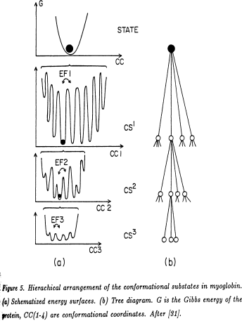
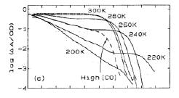
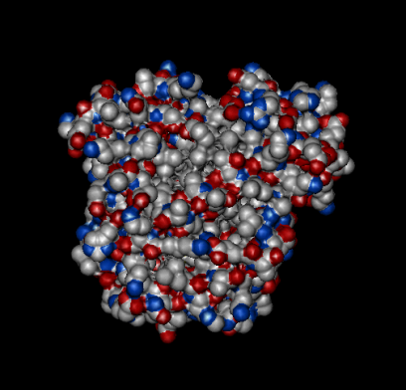
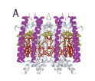
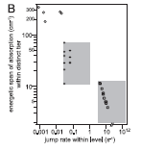
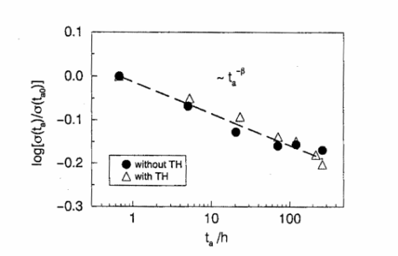
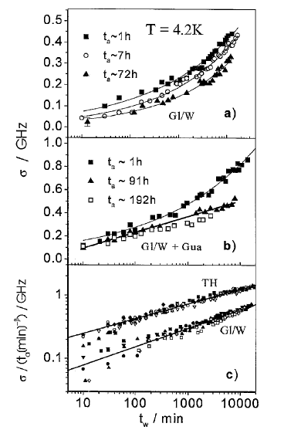
Summary : Non-Archimedean mathematics allows to see that protein molecule behaves similarly in a very large temperature range, from physiological (room) temperatures up to the cryogenic temperatures. This is due to very peculiar architecture of protein molecule: It is designed as a self-similar hierarchy.

Slide 29
Ultrametricity beyond the proteins

Slide 30
Crumpled globule

Slide 31
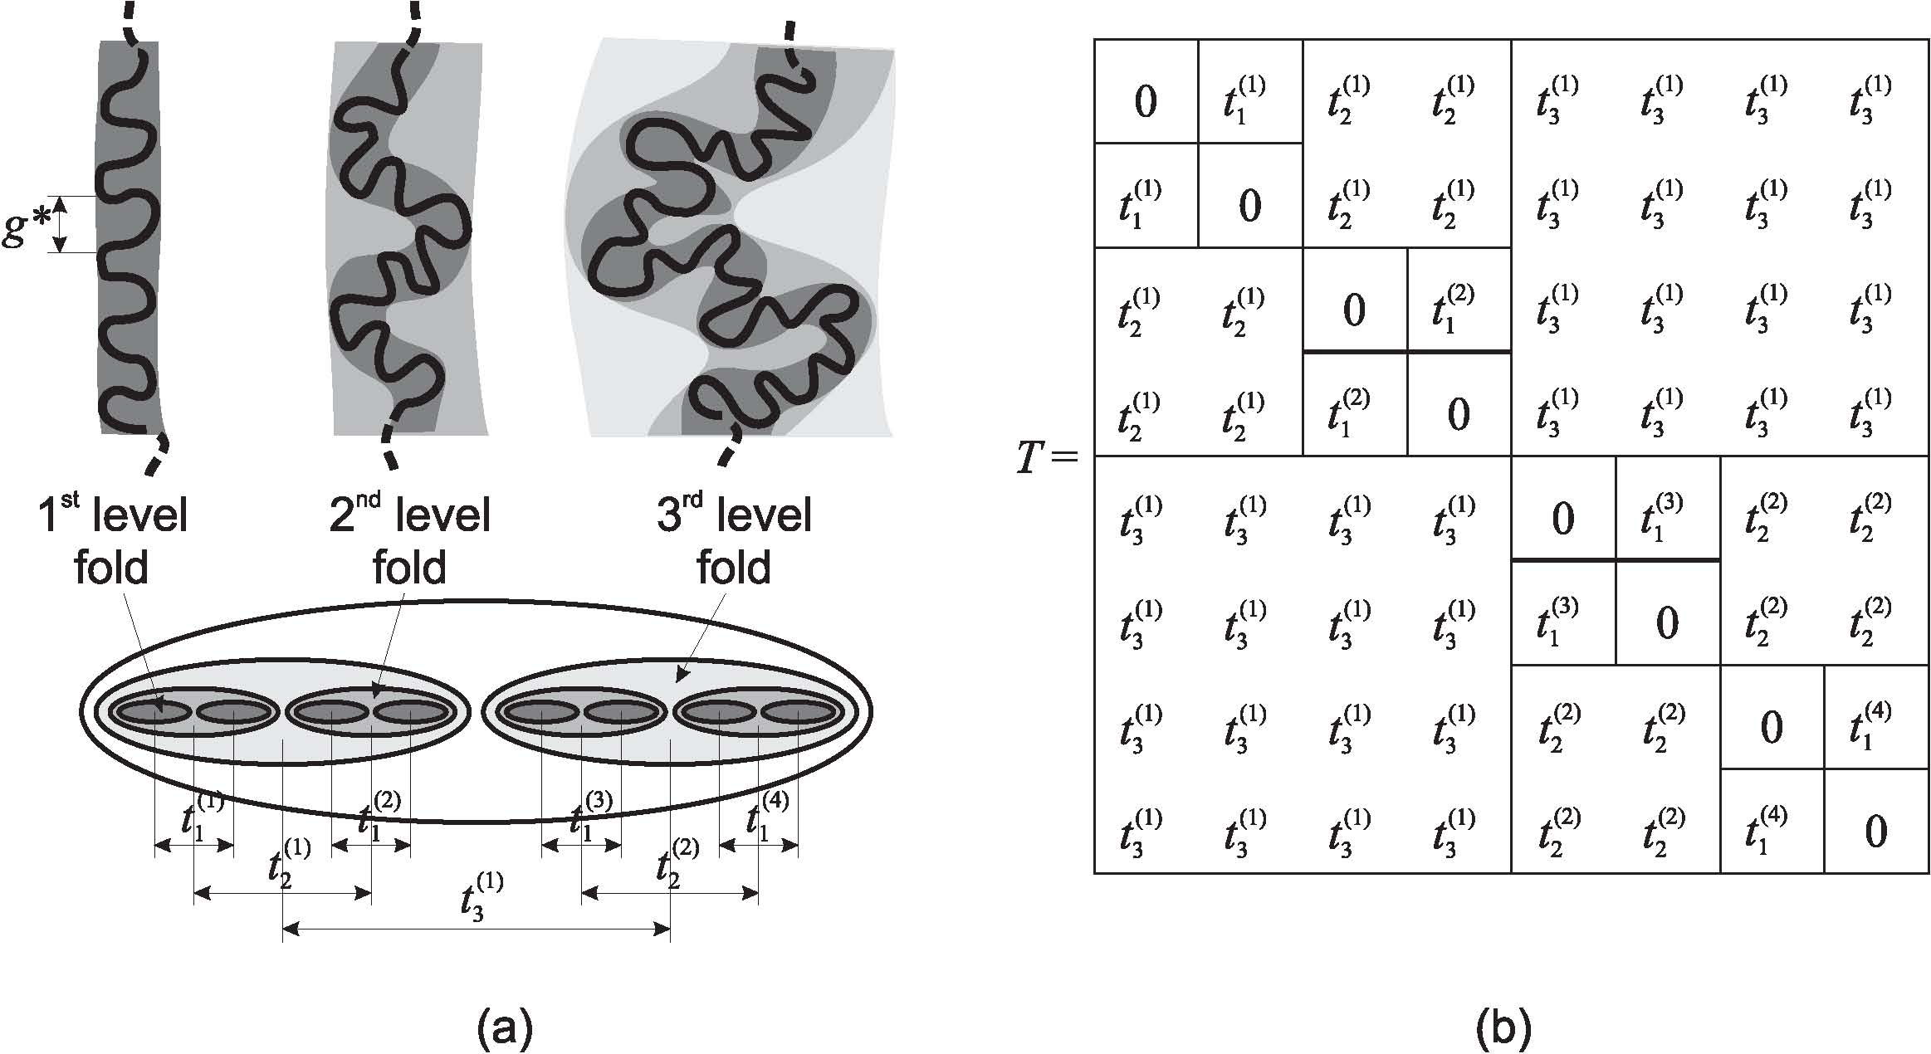
Crumpled globule is an important example of hierarchically ordered polymer structure
A. Y. Grosber, S. K. Nechaev, E. I. Shakhnovich, J. Phys. France 49, 2095 (1988).
Adjacency matrix of contacts in a crumpled globule has a block-hierarchical form like the Parisi matrix

Slide 32
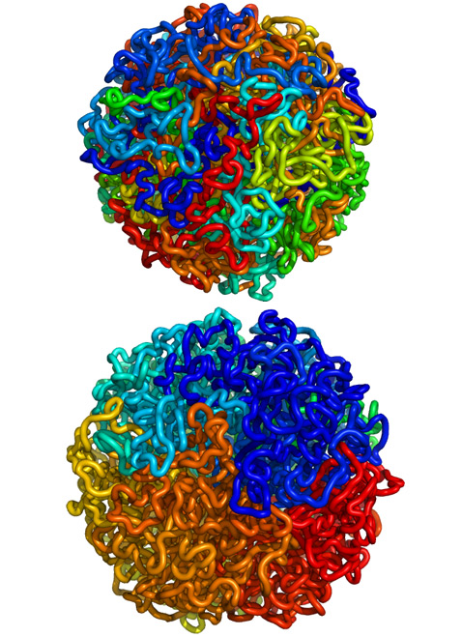
Human genome is packaged into a hierarchically folded globule
E. Lieberman-Aiden, et al, Science 2009, 326, 289 - 293
Hierarchically folded globule allows to fold the DNA molecule of 2 meters length as compact as possible, and, at the same time, quickly folding and unfolding during activation and expression of genes
Ordinary and fractal globules:
The closest sites of macromolecule are dyed in the same colors. In an ordinary globule (upper picture), different DNA-fragments are entangled. In a hierarchically folded (fractal, crumpled) globule, the genetically closest sites of DNA are not entangled and located close to each other
ordinary globule
hierarchical (crumpled) globule
(illustrations: Leonid A. Mirny, Maxim Imakaev).

Slide 33
Molecular machines

Slide 34
Molecular machines
A term ``molecular machine'' is usually attributed to a nano-scale molecular structure able to convert perturbations of fast degrees of freedom into a slow motion along a specific path in a low--dimensional phase space.
Proteins are molecular machines. This fact has been established through the studies of relaxation characteristics of elastic networks of proteins (Yu. Togashi and A.S. Mikhailov, Proc. Nat. Acad. Sci. USA {\bf 104} 8697--8702 (2007).
Elastic network models: The linked nodes are assumed to be subjected the action of elastic forces that obey the Hooke's law, and the relaxation of a whole structure is studied.
myosin

Slide 35
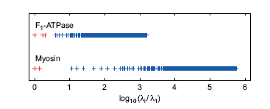
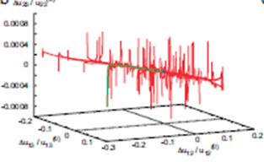
Two distinguished features of biological molecular machines (proteins)
myosin
1. There is a large gap between the slowest (soft) modes and the fast (rigid) modes
spectrum of relaxation modes
2. Being perturbed, a protein molecule, first, quickly reaches a low--dimensional attracting manifold spanned by slowest degrees of freedom, and then slowly relaxes to equilibrium along a particular path in this manifold.
1-dimentional attractive manifold in the space of protein states

Slide 36

Hierarchically folded globule possesses the properties of molecular machines:
Avetisov V. A., Ivanov V. A., Meshkov D. A., Nechaev S. K. http://arxiv.org/pdf/1303.3898.pdf
Hierarchically folded globule
hierarchically folded globule
spectrum of relaxation modes
crumpled globule
ordinary globule
$$\ln{\frac{λ_{i}}{λ_{1}}}$$
There is a large gap between the slowest mode and the fast modes
1-dimentional attractive manifold in the space of states of a crumpled globule

Slide 37
Ultrametricity is a new intriguing idea in designing of artificial “nano-machines”

Slide 38

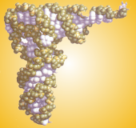
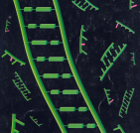
Biology
combinatorially large spaces of states;
functional behavior;
hierarchical organization
operational systems of molecular nature
(algorithmic chemistry)
lgI
5
4
3
complex molecular systems
“primary” molecular machines
Natural selection
Scale of evolutionary space, I
10⁻¹⁰⁰
Prebiology
2
Chemistry
low-dimensional spaces of states;
stochastic behavior;
global optimization.
1
stochastic molecular transformations
(stochastic chemistry)

Slide 39
Archimedean mathematics describes non-living matter, but non-Archimedean mathematics, perhaps, describes the living world.
We now are at the very beginning of this way.

