Slide 1
Introduction to Non-Archimedean Physics of Proteins.
Lecture II:
p-Adic description of multi-scale protein dynamics.
Tree-like presentation of high-dimensional rugged energy landscapes
Basin-to-basin kinetics
Ultrametric random walk
Eigenvalues and eigenvectors of block- hierarchical transition matrices
p-Adic equation of ultrametric diffusion
p-Adic wavelets

Slide 2
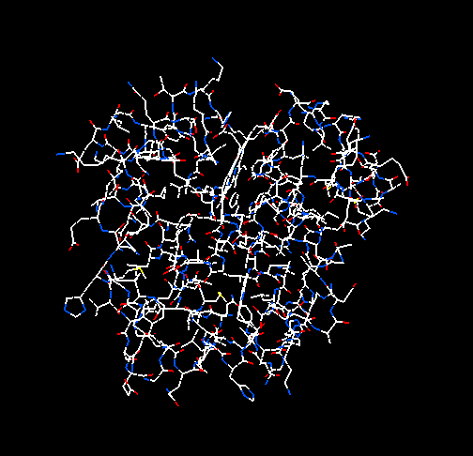
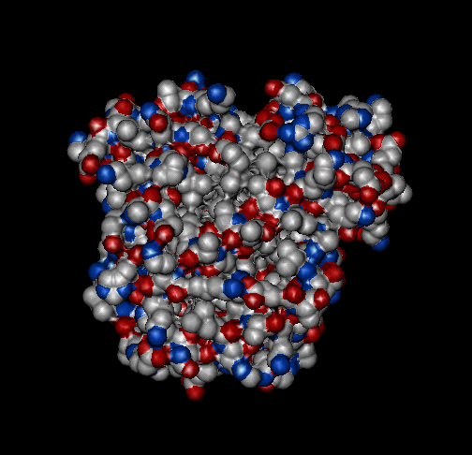
How to define protein dynamics
Protein is a macromolecule
protein states
protein dynamics
Protein states are defined by means of conformations of a protein macromolecule.
A conformation is understood as the spatial arrangement of all “elementary parts” of a macromolecule.
Atoms, units of a polymer chain, or even larger molecular fragments of a chain can be considered as its “elementary parts”. Particular representation depends on the question under the study.
Protein dynamics is defined by means of conformational rearrangements of a protein macromolecule.
Conformational rearrangements involve fluctuation induced movements of atoms, atomic groups, and even large macromolecular fragments.

Slide 3
To study protein motions on the subtle scales, say, from ~10⁻⁹ sec, it is necessary to use the atomic representation of a protein molecule.
Protein molecule consists of ~10 ³ atoms.
Protein conformational states:
number of degrees of freedom : ~ 10³
dimensionality of (Euclidian) space of states : ~ 10³
In fine-scale presentation, dimensionality of a space of protein states is very high.

Slide 4
Protein dynamics over high dimensional conformational space is governed by complex energy landscape.
protein energy landscape
Given the interatomic interactions, one can specify the potential energy of each protein conformation, and thereby define an energy surface over the space of protein conformational states. Such a surface is called the protein energy landscape.
As far as the protein polymeric chain is folded into a condensed globular state, high dimensionality and ruggedness are assumed to be characteristic to the protein energy landscapes
Protein energy landscape: dimensionality: ~ 10³;
number of local minima ~10¹⁰⁰

Slide 5
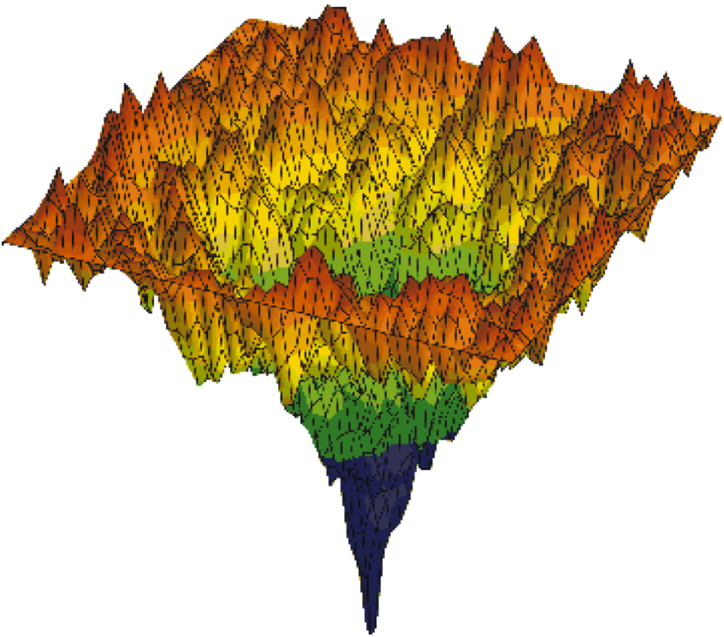
While modeling the protein motions on many time scales (from ~10⁻⁹ sec up to ~10⁰ sec), we need the simplified description of protein energy landscape that keeps its multi-scale complexity.
How such model can be constructed?
Computer reconstructions of energy landscapes of complex molecular structures suggest some ideas.

Slide 6
Computer reconstruction of complex energy landscapes
O.M.Becker, M.Karplus J.Chem.Phys. 106, 1495 (1997)
Method
Computation of local energy minima and saddle points on the energy landscape using molecular dynamic simulation;
Specification a topography of the landscape by the energy sections;
Clustering the local minima into hierarchically nested basins of minima.
Specification of activation barriers between the basins.
potential energy U(x)
conformational space
B₁
B₂
B₃

Slide 7
Presentation of energy landscapes by tree-like graphs
O.M.Becker, M.Karplus J.Chem.Phys. 106, 1495 (1997)
The relations between the basins embedded one into another are presented by a tree-like graph.
Such a tee is interpreted as a “skeleton” of complex energy landscape. The nodes on the border of the tree ( the “leaves”) are associated with local energy minima (quasi-steady conformational states). The branching vertexes are associated with the energy barriers between the basins of local minima.
potential energy U(x)
local energy minima

Slide 8
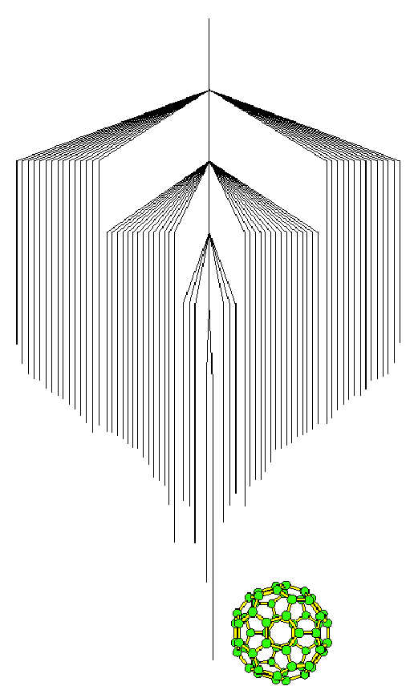
Complex energy landscapes: a fullerene molecule
Many deep local minima form the basins of comparable scales.
Ground state:
attracting basin with a few deep local minima.
C₆₀
D.J.Wales et al. Nature 394, 758 (1998)

Slide 9
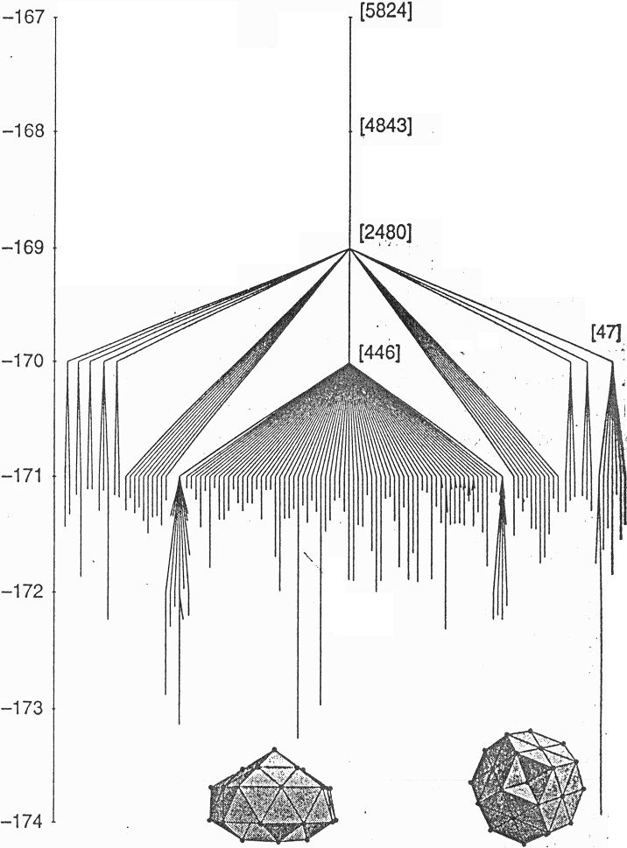
Complex energy landscapes : Lenard-Jones cluster
Many local minima form basins of different scales.
Ground state:
large attracting basin with many local minima of different depths.
LJ₃₈
D.J.Wales et al. Nature 394, 758 (1998)

Slide 10
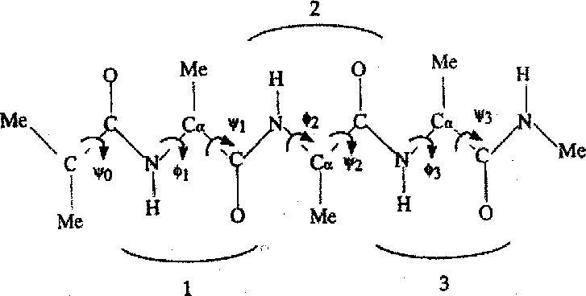
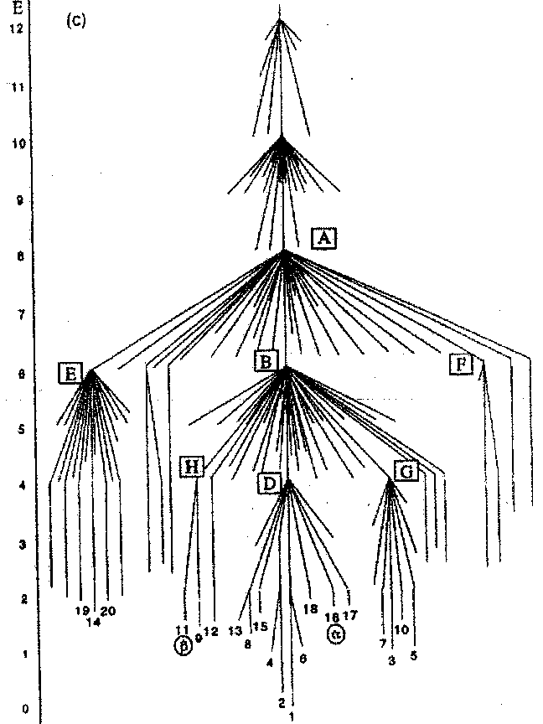
Complex energy landscapes : tetra-peptide
Many local minima form basins of relatively small scales.
Ground state is not well defined:
there are many small attracting basins.
O.M.Becker, M.Karplus J.Chem.Phys. 106, 1495 (1997)

Slide 11
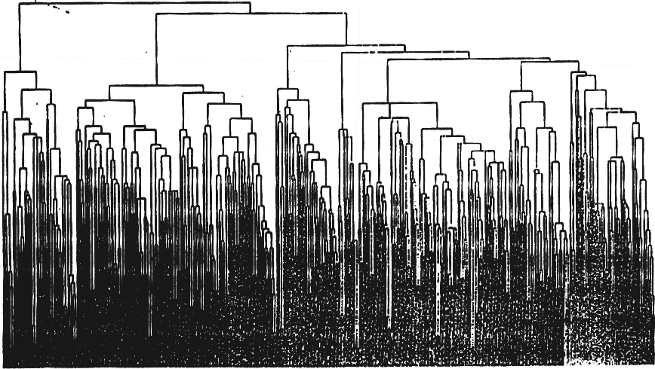
Complex energy landscapes : 58-peptide-chain in a globular state
This is a small part of the energy landscape of a crambin
Tremendous number of local minima grouped into many basins of different scales.
Ground state is strongly degenerated.
Garcia A.E. et al. Physica D, 107, 225 (1997)
(reproduced from Frauenfelder H., Leeson D. T. Nature Struct. Biol. 5, 757 (1998))

Slide 12
Complex energy landscapes : a protein
The total number of minima on the protein energy landscape is expected to be of the order of ~10¹⁰⁰.
This value exceeds any real scale in the Universe. Complete reconstruction of protein energy landscape is impossible for any computational resources.

Slide 13
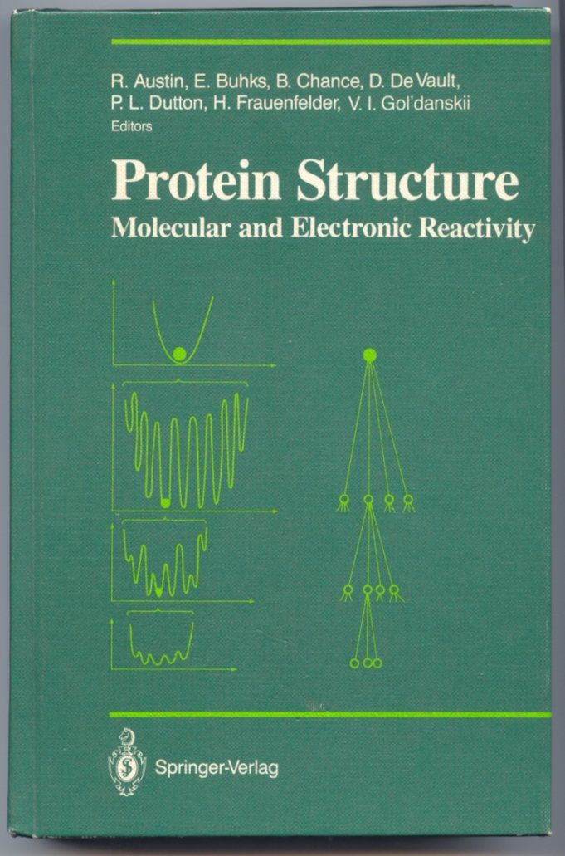
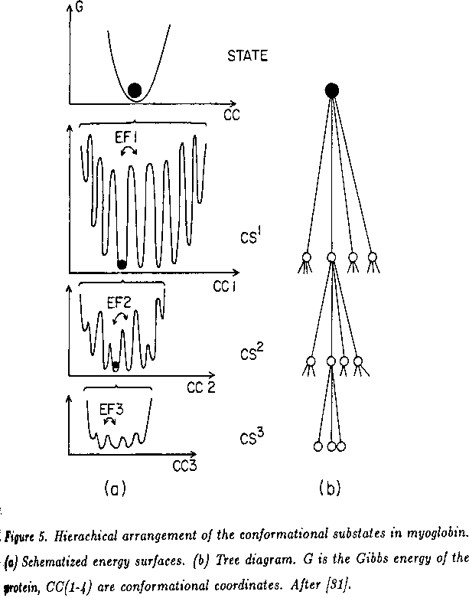
25 years ago, Hans Frauenfelder suggested a tree-like structure of the energy landscape of myoglobin (and this is all what he sad)
Hans Frauenfelder, in Protein Structure (N-Y.:Springer Verlag, 1987) p.258.

Slide 14
10 years later, Martin Karplus suggested the same idea
“In <…> proteins, for example, where individual states are usually clustered in “basins”, the interesting kinetics involves basin-to-basin transitions. The internal distribution within a basin is expected to approach equilibrium on a relatively short time scale, while the slower basin-to-basin kinetics, which involves the crossing of higher barriers, governs the intermediate and long time behavior of the system.”
Becker O. M., Karplus M. J. Chem. Phys., 1997, 106, 1495
This is exactly the physical meaning of protein ultrameticity !

Slide 15
That is, the conformational dynamics of a protein molecule is approximated by a random process on the boundary of tree-like graph that represents the protein energy landscape.

Slide 16
Random walk on the boundary of a Cayley tree
Cayley tree is understood as a hierarchical skeleton of protein energy landscape.
The leaves are the local energy minima, and each subtree of the Cayley tree is a basin of local minima.
The branching vertexes are associated with the activation barriers for passes between the basins of local minima.
w₃
w₂
w₁
Master equation
$fi$ is the transition probability, i.e. the probability to find a walker in a state $i$at instant $t$, and $wji$ is the rate of transition from $j$ to $i$. The energy landscape is represented by the transition rates $wji$

Slide 17
Matrix description
Master equation
1 2 3 4 5 6 7 8
Due to the basin-to-basin transitions, transition matrix W has a block-hierarchical structure.
For regularly branching tree, any matrix element $wji,$ is indexed by the hierarchy level γ of that vertex over which the transition occurs
$$wji =wij=w$$

Slide 18
Indexation of the transition matrix elements:
non-regular hierarchies with branching index p=2
C (2,2)
$$γ=2, n=2$$
2-adic (2-branching) Cayley tree:
each branching vertex is indexed by a pair of integers $(γ,n_{γ})$, where $γ$ specifies the level at which the vertex lies, and $n$ specifies the particular vertex over which the transition occurs.
For example: A=(1,1), B=(1,2), C=(2,2).
B (1,2)
A (1,1)
1 2 3 4 5 6 7 8
Translation-non-invariant transition matrix
The elements of the transition matrix W can be indexed by the pairs of integers $(γ,n_{γ})$.
$$w_{ij}=w_{ji}=w_{γn_{γ}}$$

Slide 19
Indexation of the transition matrix elements:
random walk on $p$-branching Cayley tree, $p>2:$
$$p=3$$
$$γ$$
$$n_{γ}$$
Given the transition $i→j$ we, first, find a minimal subgraph to which both sites $i$ and $j$ belong. In other words, we find a minimal basin in which the transition $i→j$ takes place. This basin is presented by the particular vertex $(γ, nγ)$ lying on level $γ$ of the tree. Then, we go down to the lower lying $p$ subbasins $\left\{\left(γ−1,n_{γ−1}^{\left(1\right)}\right),…,\left(γ−1,n_{γ−1}^{\left(p\right)}\right)\right\}$ and find a particular pair of maximal subbasins between which the transition $i→j$ occurs.
Thus, the elements $w_{ij}$ of the transition matrix $W$ can be indexed by three integers, e. g., by a pair $(γ, n_{γ})$ that indicates the smallest basin in which the transition occurs, and an additional index $k, 1≤k≤p−1,$ that fixes a pair of the largest subbasins between which the transition takes place.
$$k=1$$
$$k=2$$
$$w_{γnk}$$
$$γ−1$$
$$i$$
$$j$$
$k=$2
$$w_{γnk}$$
$$i$$
$$j$$
$$k=1$$
The pair of subbasins that specifies the transition from site $i$ to site $j$ over the vertex $\left(γ,n_{γ}\right)$
minimal basin $\left(γ,n_{γ}\right)$ in which the transition takes place

Slide 20
Eigen vectors and eigenvalues of symmetric block-hierarchical transition matrices

Slide 21
Eigenvectors (ultrametric wavelets)
An eigenvector of a symmetric block-hierarchical transition matrix specifying a random walk on $p$-adic Cayley tree with $Γ$ levels, is a column vector that consist of blocks of components according to the hierarchy of basins. For each level $γ$, there are $(p−1)p^{γ}$ eigenvectors ${\vec{e}}_{p}(γ,n_{γ},k)$. Each eigenvector consists of $p^{Γ−γ}$ blocks with $p^{γ}$ elements, and only one block has nonzero components. The non-zero block consists of $p$ sub-blocks with $p^{γ−1}$ identical components in each. These components are the complex numbers $exp\left[2πiφ(γ,n_{γ},k)\right]$ such that the sum of all components in non-zero block is equal to 0.
Thus, each eigenvector is indexed by a triple $(γ, nγ, k)$. The triple specifies the scale of nonzero block in the column vector $(p^{γ})$ , the position of non-zero block in the column vector ${(n}_{γ})$, and the values of non-zero components, $exp\left[2πiφ(γ,n_{γ},k)\right]$.
р=3: one of the 1st-level eigenvectors

Slide 22
Examples:
Eigenvectors and eigenvalues of symmetric block-hierarchical 2-adic transition matrix
3,1
energy barriers
2,2
2,1
1,2
1,3
1,1
1,4
1 2 3 4 5 6 7 8

Slide 23
p=2
four 1st-level eigenvectors
(3,1)
four 1st-level eigenvalues
(2,2)
(2,1)
(1,2)
(1,1)
(1,3)
(1,4)
1 2 3 4 5 6 7 8

Slide 24
p=2
two 2nd -level eigenvectors
(3,1)
two 2nd-level eigenvalues
(2,2)
(2,1)
(1,2)
(1,1)
(1,3)
(1,4)
1 2 3 4 5 6 7 8

Slide 25
p=2
one 3rd -level eigenvector
(3,1)
one 3rd -level eigenvalue
(2,2)
(2,1)
(1,2)
(1,1)
(1,3)
(1,4)
1 2 3 4 5 6 7 8

Slide 26
p=2
eigenvector of the equilibrium state
eigenvalue of the equilibrium state

Slide 27
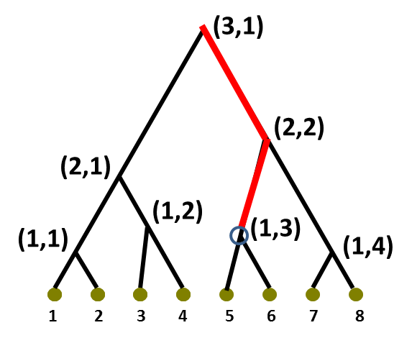
Simple rule:
eigenvalue is the total rate to exit particular basin
formula for non-zero eigenvalues: (p=2)

Slide 28
p-Adic description of ultrametric random walk
The basic idea:
In the basin-to-basin approximation, the distances between the protein states are ultrametric, so they can be specified by the p-adic numerical norm, and transition rates can be indexed by the p-adic numbers.

Slide 29
Parameterization of ultrametric lattice by p-adic numbers
V.A.Avetisov, A.Kh.Bikulov, S.V.Kozyrev J.Phys.A:Math.Gen. 32, 8785 (1999)
ultrametric lattice
Cayley tree is a graph of ultrametric distances between the sites. At the same time, this tree represents a hierarchy of basins of local minima on the energy landscape.
1 2 3 4 5 6 7 8
0 1 1/2 3/2 1/4 5/4 3/4 7/4
2²
2¹
2⁰
0 1 1\2 3\2 1/4 5/4 3/4 7/4
ultrametric distances between the sites

Slide 30
р-adic equation of ultrametric diffusion
Avetisov V A, Bikulov A Kh , Kozyrev S V . Phys.A:Math.Gen. 32, 8785 (1999);
Arrhenius law connects mathematics and physics: $w({\left|x−y\right|}_{p})\sim exp⁡\left\{−\frac{E({|x−y|}_{p})}{kT}\right\}$
master equation of random walk on ultrametric lattice
energy landscape
parameterization of the lattice states $\{i\}$ by rational numbers $x∈X$;
specification of the transition rates $w_{ij}$ as a function on ultrametric distance, $w({|x−y|}_{p})$
continuous limit $X⇒ℚ_{p}$
p⁰
p¹
ultrametric distance
p³

Slide 31
Thus, we can consider the p-adic equation of ultrametric random walk as a model of macromolecular dynamics on particular energy landscape
In fact, this p-adic equation describes very well the complicated protein dynamics on many time scales

Slide 32
Eigenvectors of block-hierarchical transition matrixes is described by p-adic wavelets

Slide 33
p=2
1st-level eigenvector
(3,0)
1st-level wavelet
(2,1/8)
(2,0)
(1,1/4)
(1,1/8)
(1,0)
(1,3/8)
0 1/2 1\4 3\4 1/8 5/8 3/8 7/8

Slide 34
p=2
2nd -level eigenvector
(3,0)
2nd -level wavelet
(2,1/8)
(2,0)
(1,1/4)
(1,1/8)
(1,0)
(1,3/8)
0 1/2 1/4 3/4 1/8 5/8 3/8 7/8

Slide 35
p=2
3rd -level eigenvector
(3,0)
3rd -level wavelet
(2,1/8)
(2,0)
(1,1/4)
(1,0)
(1,1/8)
(1,3/8)
0 1/2 1/4 3/4 1/8 5/8 3/8 7/8

Slide 36
Given the transition rates $w({|x−y|}_{p})$, i.e. a hierarchical skeleton of the energy landscape, one can solve a Cauchy problem for the p-adic equation of ultrametric diffusion:
and then calculate some observables using the solution $f\left(x,t\right)$.
In many experiments, the dynamics is observed as a relaxation process (survival probability)

Slide 37
Characteristic relaxations in complex molecular systems
V.A.Avetisov, A.Kh.Bikulov, V.Al.Osipov. J.Phys.A:Math.Gen. 36 (2003) 4239
“soft” (logarithmic) landscape
stretched exponent decay
self-similar (linear) landscape:
power decay
“robust” (exponential) landscape:
logarithmic decay

Slide 38
A type of relaxation suggests particular tree for tree-like presentation of energy landscape
Power kinetics of CO rebinding to myoglobin and power broadening of the spectral diffusion suggest that the activation barriers between the basins of local minima linearly grow with hierarchical level $γ$.
Thus, the power-law relaxation typical for proteins suggests the particular form of p-adic equation of protein dynamics:

Slide 39
Summary:
p-Adic description of multi-scale protein dynamics is based on:
Tree-like presentation of high-dimensional rugged energy landscapes and basin-to-basin-kinetics.
p-Adic description of ultrametric random walk on the boundary of a p-branching Cayley tree.
Particular form of the p-adic equation of ultrametric diffusion given by the Vladimirov operator.

Slide 40
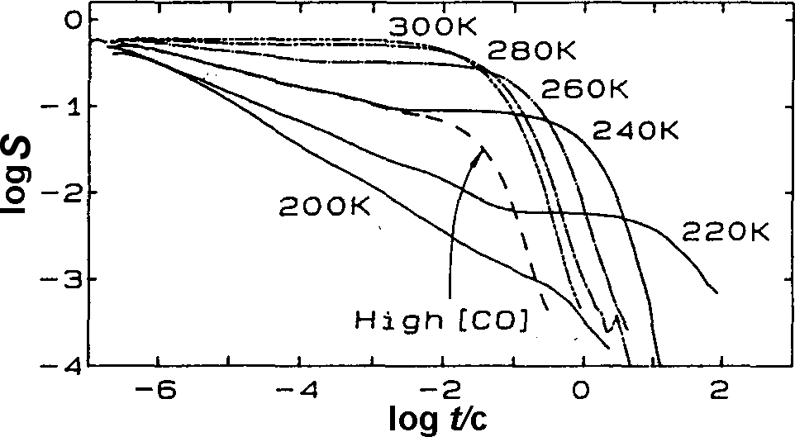
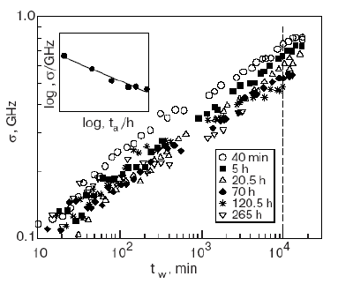
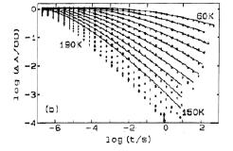
With the p-adic equation in hands, we can describe all features of CO rebinding and spectral diffusion in proteins
Mb*
?
?
Mb₁
protein conformational space
X
binding CO

