Slide 1
Introduction to Non-Archimedean Physics of Proteins.
Vladik Avetisov
Semenov Institute of Chemical Physics,
Russian Academy of Sciences, Moscow

Slide 2
Lecture I: Proteins and Protein Dynamics.
Proteins: How they look and what they do.
Two classical experiments: CO rebinding to myoglobin and spectral diffusion in frozen proteins.
Puzzles and problems.
Lecture II: p-Adic description of multi-scale dynamics on protein energy landscape.
Tree-like presentation of high-dimensional rugged energy landscapes.
Basin-to-basin kinetics.
Ultrametric space of states, ultrametric diffusion, p-adic master equation, and the solutions.
Lecture III. Applications.
First passage time distribution for ultrametric random walk and spectral diffusion in frozen proteins.
p-Adic equations of the "reaction-diffusion" type and CO-rebinding to myoglobin.
Concluding remarks: molecular machines, DNA packing, the origin of life.

Slide 3
Lecture I: Proteins and Protein Dynamics.
Proteins: How they look and what they do.
Two classical experiments: CO binding to myoglobin and spectral diffusion in frozen proteins.
Puzzles and problems.

Slide 4
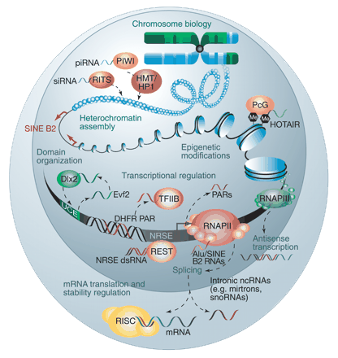
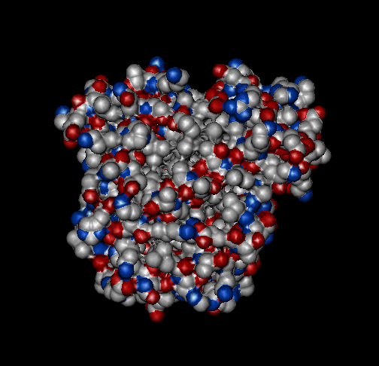
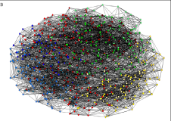
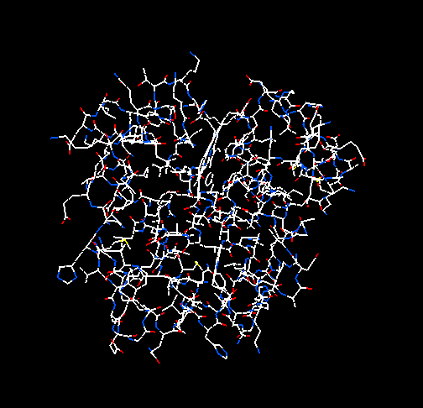
Protein - what is it?
Proteins are the operational units in a cell. They work as “molecular machines” which precisely manipulate by solitary charges, atoms, or molecules against fluctuations. In some sense, a cell is the operational system that is formed from molecular machines and produce molecular machines. Proteins are in the core of these processes.
complex metabolic network in a cell
On the other hand, proteins look like the nano-scale polymeric “drops”, and therefore they, would seem, can be easily fabricated from many polymers. Nothing of the kind! It is not yet clear why protein molecules work as “nano-machines”, and we still do not know how to make them.

Slide 5
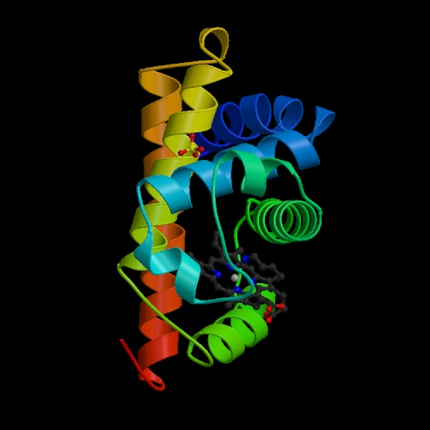
Protein molecule in different presentations
active center
atomic presentation
helix motives in native conformation
This is a myoglobin, the famous protein, “a hydrogen atom in biophysics” (Hans Frauenfelder). Myoglobin is formed by a relatively short polypeptide chain with the length about of 150 units (~2000 atoms). It is folded in to very peculiar structure consisting of 8 helixes ordered around the active center. Binding of small ligands (O₂ , СO, NO) is the biological function of myoglobin.

Slide 6
Complexity of a protein structure can be seen from the architecture of chemical bonds in myoglobin
Protein structure does not have translational and rotational symmetry, so it can not be simplified by the space symmetry.
In addition to chemical bonds, the atoms in a protein molecule interact by different forces of electromagnetic nature, e.g. hydrogen bonds, Coulomb and Van der Waals forces, dipole-dipole interactions, etc. Therefore, protein molecule has very complicated network of interatomic interactions.

Slide 7
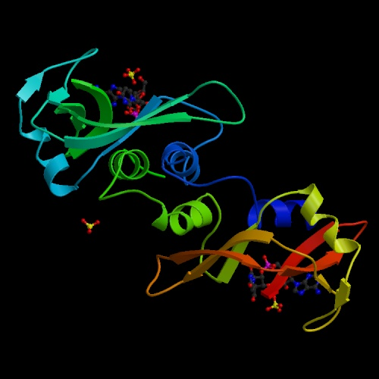
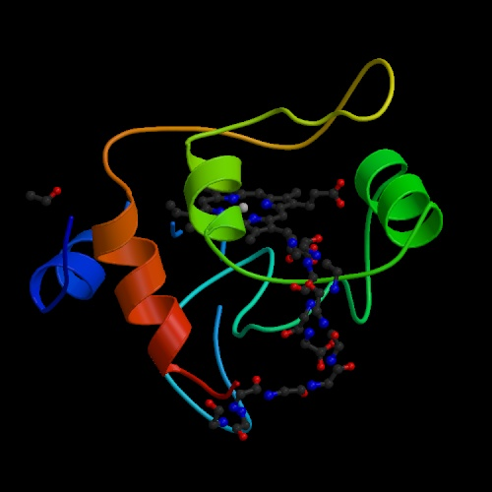
Many proteins are much more complicated than myoglobin.

Slide 8
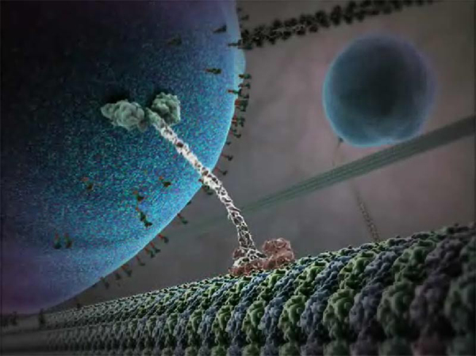
Proteins actually do amazing things. Kinesin, for example, operates as a locomotive. It uses an ATP molecule as a fuel, converts chemical energy into mechanical motion, and lugs a huge vesicle along a cytoskeletal filament.
from “Inner cell life”

Slide 9
Chemists and biochemists often say that proteins act as chemical catalysts. They believe that exactly the "active site“, where the chemical transformation occurs, is the most important part of a protein molecule.
In fact, this is very robust interpretation, because it represents the protein functioning as a “chemical collision” of the stochastic, not the operational nature.
Chemistry: One successful outcome from billions collisions.
Protein functioning: One mistake in billions acts.

Slide 10
In opposite to chemists, physicists suggest that protein functioning is mainly determined by protein dynamics. Somehow, protein molecule controls chemical transformations in the protein active site on extremely wide range of scales – from tenths of an angstrom (10⁻¹ Å ) and nano-seconds (10⁻⁹ sec) up to a dozen of angstroms (10 Å) and the seconds (10⁰ sec ).
In fact, protein extends an elementary act of chemical transformation in the active site.
Chemical catalyst works imprecisely, but very fast, while protein works very precisely, but slowly.

Slide 11
The key problem is exactly to find mathematically reasonable and physically transparent language for very complicated picture of multi-scale protein dynamics and protein functioning.
Relevant experiments are basically important here.

Slide 12
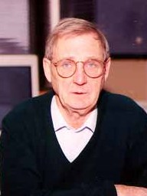
One such experiment was set up by Hans Frauenfelder‘s group (CNLS-LANL) almost 30 years ago. To understand how protein works, they studied the CO binding to myoglobin in a large time window and very wide temperature range, from the room temperature up to the cryogenic temperatures.
Hans Frauenfelder, CNLS LANL, USA

Slide 13
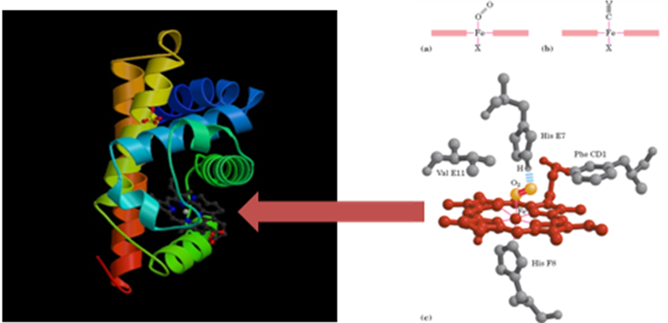
Experiment: CO rebinding to myoglobin
(H. Frauenfelder’s group, since the end of the 1970th)
measurand :.
concentration of free (unbounded) Mb.
stressed (inactive) state
Mb*
conformational rearrangements of the Mb
Mb₁
equilibrated (active) state
CO
breaking of chemical bound
Mb-CO
rebinding CO to Mb
Mb-CO
Mb-CO
hν
laser pulse

Slide 14
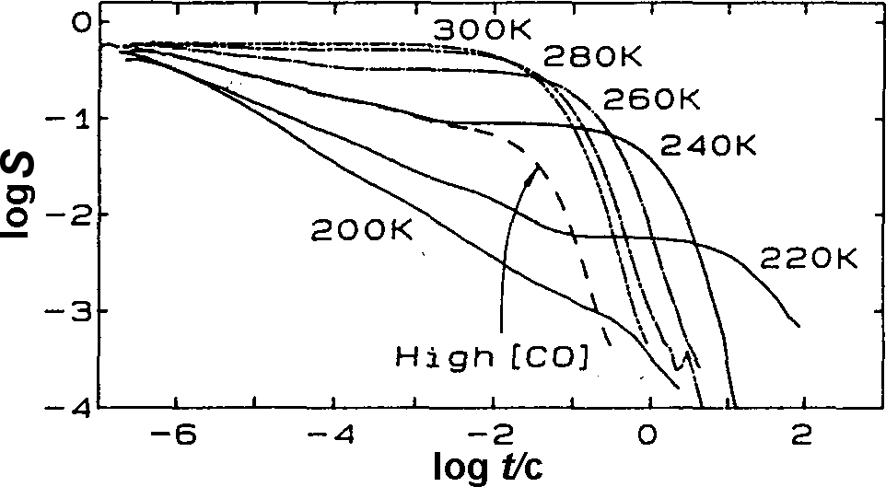
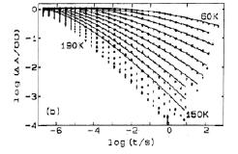
CO rebinding kinetics
(H. Frauenfelder’s group, since the end of the 1970th)
High temperature kinetics
phase transition with sharp reduction in scales of fluctuation
Low temperature kinetics

Slide 15
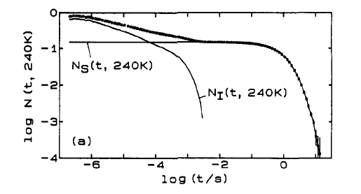
Steinbach P. J. et al. Biochemistry, 30, 3988 (1991)
High-temperature kinetics follows a power law with anomalous temperature behavior
exponential decay (for those CO that left the active center)
power decay
(for those CO that remained in the active center)
Power-law kinetics appears due to the influence of protein dynamics.

Slide 16
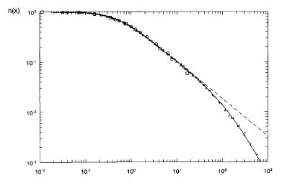
Steinbach P. J. et al. Biochemistry, 30, 3988 (1991)
Low-temperature kinetics follows the rational fit with normal temperature behavior
Kinetic curves can be re-scaled to the master-plot
Zharikov A. A., Fisher S. J. Phys. Chem. 263, 749 (1996)
Again, power-law kinetics appears due to the influence of protein dynamics.

Slide 17
The exponents of the power-law approximations for long-time kinetics at high temperatures and low temperatures are dramatically different.
high-temperature kinetics
$300÷200 K$
dependences of characteristic exponents on the temperature
$$−\left(1−\frac{T}{T_{0}}\right)$$
$$−\frac{T}{T_{0}}$$
characteristic exponent
low-temperature kinetics
$180÷60 K$
high-temperature region
low-temperature region
$$≈\frac{1}{200}$$
$$\frac{1}{T}$$

Slide 18
Frauenfelder’s interpretation
Initial interpretation of the CO rebinding kinetics was given by Frauenfelder’s group. They suggested that at low temperatures protein molecules are frozen in different conformational substates, so the reaction rate is combined by contributions of many activation barriers distributed over the sample:
$$n\left(t,T\right)=\int_{0}^{∞}{e^{−k\left(H,T\right)t}g(H)dH}$$
$n(t,T)$ is the concentration of (unbounded ) myoglobin at the instant $t$, $T$ is the temperature, $k\left(H,T\right)$ is the rate constant related to the activation barrier $H$.
This interpretation, however, run many difficulties. It turned out that at high and low temperatures one need to introduce drastically different energy profiles for one and the same reaction, and, in addition, to postulate that the activation barriers depend on temperature and time.

Slide 19
Main conclusion that comes from Frauenfelder’s interpretation
In contrast to the native proteins, at low temperatures, the protein is similar to frozen disordered condensed matter like glassy system.
In other words, frozen proteins are drastically differ from the native proteins.
In fact, this conclusion has far-reaching consequences, since the proteins are often studied at cryogenic temperatures.
0
$$−\left(1−\frac{T}{T_{0}}\right)$$
$$−\frac{T}{T_{0}}$$
characteristic exponent
high-temperature region: functionally active state
low-temperature region: glassy-like frozen state
$$≈\frac{1}{200}$$
$$\frac{1}{T}$$

Slide 20
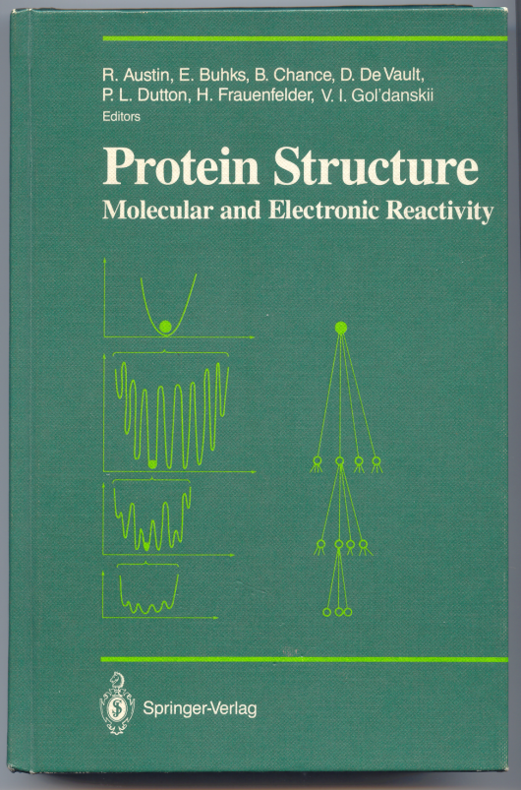
At the same time, Frauenfelder stated, that the protein conformational substates have a tree-like order: “The results sketched so far suggest <…> ultrametricity.”
(Hans Frauenfelder,
in Protein Structure (N-Y.:Springer Verlag, 1987) p.258.)
Thus, from the very beginning, the idea about protein ultrametricity fell into an ambiguous position. On the one hand, it was stated that the rebinding kinetics suggests the protein ultrametricity, yet not quite clear how exactly, and at the same time it was shown that the observable kinetics can be described by the models which have nothing to do with ultrametricity.

Slide 21
Opposite interpretation
A little later, Zharikov and Fischer from the Munich Technical University proposed completely opposite interpretation. They suggest that , at low-temperatures, i.e., exactly where the assumption about the frozen protein looks natural, just the protein dynamics plays the decisive role.
They considered a model
$n\left(t\right)=〈exp\left\{−\int_{0}^{t}{k\left(x\left(t′\right)\right)dt′}\right\}〉$
where $k(x(t))$ is the reaction rate constant which is regulated by some random process $x\left(t\right)≥0;$ the measured quantity $n(t)$ is an average over the trajectories $x\left(t\right)$. The regulation lies in the fact that the reaction is active only on some time intervals, when the trajectories of the random process $x\left(t\right)$ hit into particular area:
$$k\left(x\left(t\right)\right)=\left\{\begin{aligned}k_{0} if 0≤x(t)≤1 \\ 0 if x(t)>1\end{aligned}\right.$$

Slide 22
“High-temperature catastrophe”
It was found that, when the number of such hits increases with time as $\sim t^{T/{T_{0}}}$, then the rebinding kinetics is described exactly by the power-law $n\left(t\right)\sim t^{−T/{T_{0}}}$ indeed abserved in low-temperature region.
However, in this case, the Zharikov-Fischer model directly contradicts the actual kinetics in high temperature region.
In high-temperature region, where the mobility is higher, and, it would seem, the Z-F-model should work better, it falls completely.
0
actual behavior
characteristic exponent
Zharikov-Fischer-model
high-temperature region
low-temperature region
$$≈\frac{1}{200}$$
$$\frac{1}{T}$$

Slide 23
CO-rebinding brought many difficulties for the theory
As a result of all these efforts, an ambiguous view was formed on Frauenfelder’s experiments. It was seemed that protein molecule is found in very different states at physiological and low temperatures. At the same time, it was remained unclear which of two factors –protein structure or protein dynamics - is the main one for protein functioning.
With regard to the protein ultrametricity, this idea had proved to outside the discussion. Moreover, despite inconsistency and incompleteness of all theoretical interpretations proposed at that time, a common opinion had taken that CO rebinding kinetics can be described using various models which do not have any relation to the ultrametricity, and, it is rather difficult to justify this idea using CO-rebinding kinetics.

Slide 24
Is the protein molecule indeed frozen at low temperatures?

Slide 25
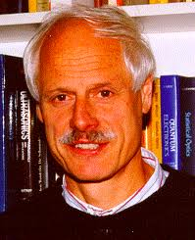
The answer was obtained from another classical experiments, which were set up by Joseph Friedrich’s group from the Munich Technical University in last two decades.
To understand how a protein molecule fluctuates they studied the spectral diffusion in globular proteins at the liquid helium temperature.
An overall picture that was appeared through these efforts turned out fully unexpected.
Josef Friedrich, Munich Technical University, Germany

Slide 26
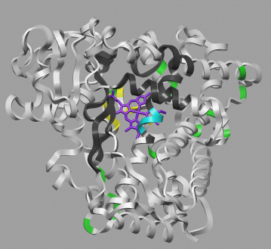
hole burning spectroscopy
chromophore marker
1. Chromophore markers are injected inside the protein molecules. A sample is frozen up to a few Kelvin, and the adsorption spectrum is measured.
Due to variations of the atomic configurations around the chromophore markers in individual protein molecules, the spectrum is inhomogeneously broadened at low temperatures.
2. Using laser pulse at some absorption frequency, a subset of markers in the sample is subjected irreversible photo-transition. Thus, a narrow spectral hole is burned in the absorption spectrum.
3. The time evolution of the hole wide is measured.
protein, cytochrome C
Because the marker surroundings in protein molecules randomly change, the burned hole broadens with time. Thus, hole burning spectroscopy allows to see how individual absorption lines “diffuses” in frequency.

Slide 27
chromophore
How spectral diffusion is coupled with local changes of marker’s surroundings
Consider an atom that is located closely to the marker. Since the marker absorption frequency randomly changes, the atom changes its position.
There are two ways for such changes.
protein
chromophore
neighboring atom

Slide 28
One possibility
The local potential, at which our atom is found, is not changed, but there are various local minima over which the atom jumps.
If the potentials are formed randomly, the theory predicts logarithmic broadening of the hole wide :
$$σ\sim \ln{t}$$
Such relaxation processes is typical for glasses.
local potential
Position of our atom

Slide 29
Another way
The local potential for our atom is not frozen. It is transformed from time to time, and our atom, following this transformation, changes its own position.
The time behavior of the hole wide $σ(t)$ depends on statistics of the random transformations of local potentials.

Slide 30
Whether the protein is frozen at low temperature or not, can be understood from the spectral diffusion broadening.
Is it logarithmic, or not?

Slide 31
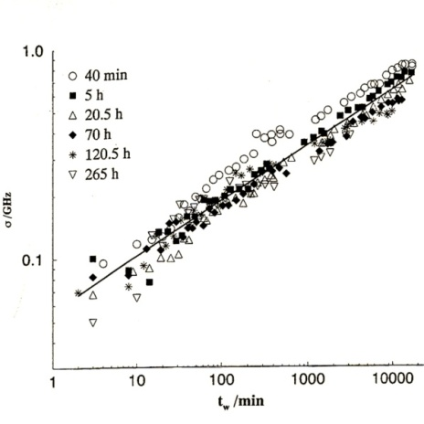
Weighting and aging times
aging time
The “aging time”, t_{ag} , is the interval between the time point, at which a sample is suggested to be in a prepared state, and the time point at which a hole is burned.
hole wide
The “weighting time”, t_{w} , starts immediately after burning of the hole, i.e. it is the current time for spectral diffusion.
weighting time

Slide 32
Native proteins have
universal properties
of spectral diffusion
(the proteins that are remained functionally active after freezing- unfreezing cycles)

Slide 33
A spectral hole is well approximated by Gaussian distribution.
Thus, the spectral diffusion in deeply frozen proteins can be regarded as a Gaussian random process propagating along the frequency straight line.

Slide 34
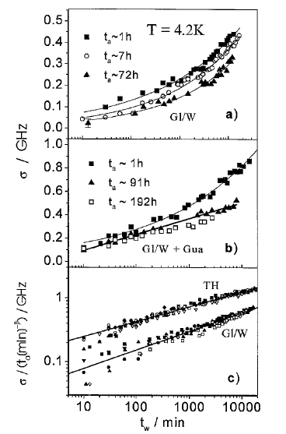
Spectral diffusion broadening
In native proteins, the spectral diffusion broadening follows the power law with the exponent ≈ 0,27
The exponent of familiar (Brownian) diffusion is equal to 0.5 . With this respect, spectral diffusion in proteins propagates anomalously slow
Spectral diffusion in denatured proteins is broadened logarithmically ($\sim \ln{t_{w}}$). Spectral diffusion in native proteins propagates exponentially faster then in denatured proteins
At low temperatures, denatured proteins are similar to glasses, but native proteins are not the case.

Slide 35
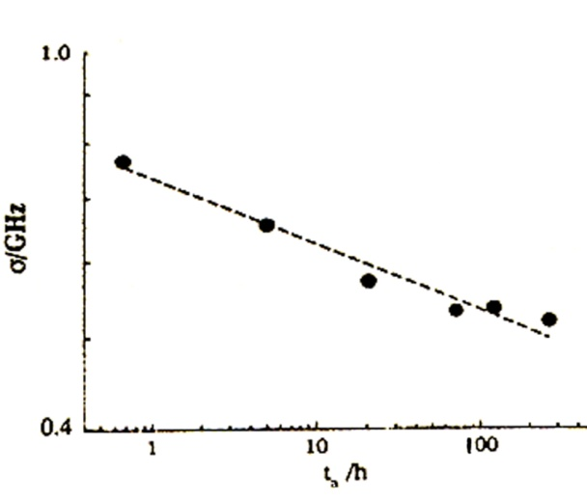
Spectral diffusion “aging”
When the aging time ( t_{ag}) grows, the spectral diffusion propagates slower and slower.
For fixed waiting time (t_{w}≈10⁴min), the spectral hole width decreases with aging time t_{ag} following a power law with characteristic exponent ≈ -0.07.

Slide 36
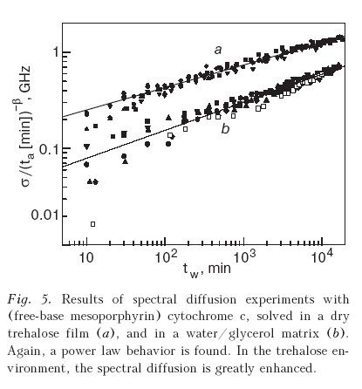
Protein is not a glass-like system even at liquid helium temperature!
At low temperatures, fluctuation-induced protein mobility is characterized by two specific features
SD-broadening
SD-aging

Slide 37
Summary:
CO-rebinding to myoglobin and spectral diffusion in frozen proteins show that protein molecule has high mobility even at the cryogenic temperature.
Both experiments show that the random local movements of the protein atomic structure strongly depend on non-local mobility of the protein molecule.
Both experiments show that the protein dynamics is a multi-scale random process and this property holds on anomalously wide temperature range from 300 K up to 4 К.

Slide 38
On the final lecture we will see that all these features are, in fact, the manifestations of the protein ultrametricity.

